Slide 1
Using Evolutionary Algorithms for Finding Optimal Initial Conditions in a Zero-Player Game
CL643
Guided by Prakash Kotecha
Manchikatla Navya Sri
190102050
Rohit Priyanka Nandwani
180121035
Notes:
We designed this template so that each member of the project team has a set of slides with its own theme. Members, here’s how you add a new slide to just your set:
Mark where you want to add the slide: Select an existing one in the Thumbnails pane, click the New Slide button, then choose a layout. The new slide gets the same theme as the other slides in your set.
Careful! Don’t annoy your fellow presenters by accidentally changing their themes. That can happen if you choose a different theme from the Design tab, which changes all of the slides in the presentation to that look.

Slide 2
Agenda
Background
Project Description
Objective Function – 1
Objective Function – 2 [Objective 1 + time-step minimization]
Brute Force (First Objective)
Comparison of a few Existing Techniques (First Objective)
Comparison of a few Existing Techniques (Second Objective)
Conclusion

Slide 3
Background
Zero-Player Game
A game that evolves as determined by its initial state, requiring no further input from humans is considered a zero-player game.
Cellular automaton games that are determined by initial conditions including Conway's Game of Life are examples of this.
Here, we deal with such a physics based zero-player maze game where a ball shooted from a fixed points needs to be given initial velocity. After that, the ball bounces off the walls in the environment. The game is “won” if the ball goes inside a bucket instead of escaping to infinity.

Slide 4

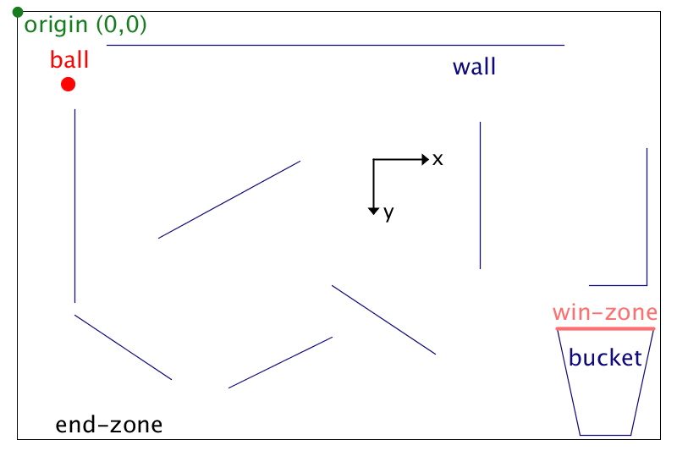


Project Description
Assumptions:
Coefficient of restitution, $e=1$
Total of 12 walls as shown in the figure
Ball departure point is fixed for all throws
Fixed boundary as a end-zone
Lid of the bucket as win-zone
Ball disappears after reaching end-zone or win-zone; and the simulation ends

Slide 5
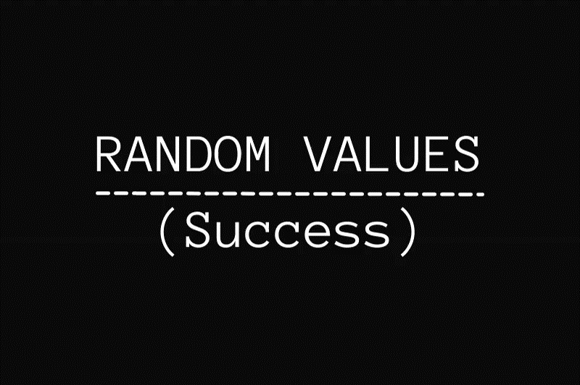
Project Description
Objectives
Objective-1: The ball should reach the win-zone (i.e- the bucket).
Objective-2: The ball should reach the win-zone in the least amount of time possible.

Slide 6
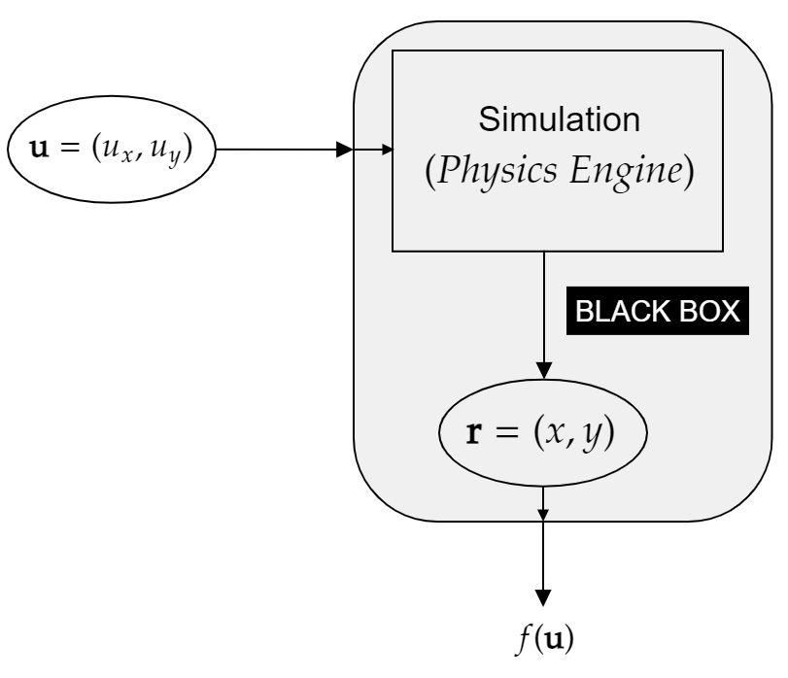
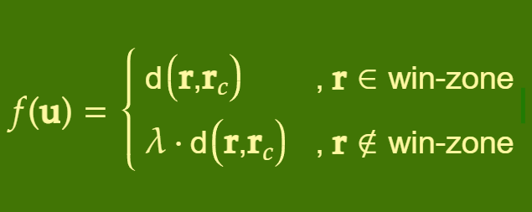

Objective Function-1
Decision variables : u $=(u_{x},u_{y})$
Final coordinate of ball before ball disappears $(r)$
Midpoint of win-zone $(r_{c})$
Objective function
, where the factor of $λ(=10)$ is introduced to create a bias towards the win-zone, in contrast to the remaining end-zone.

Slide 7
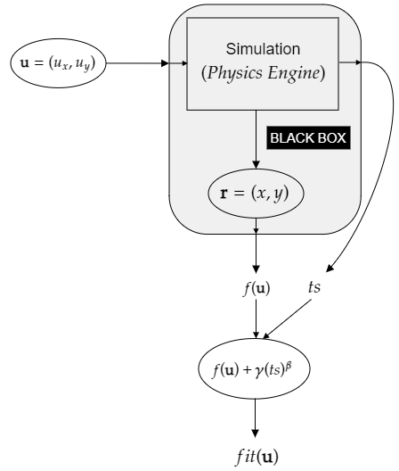
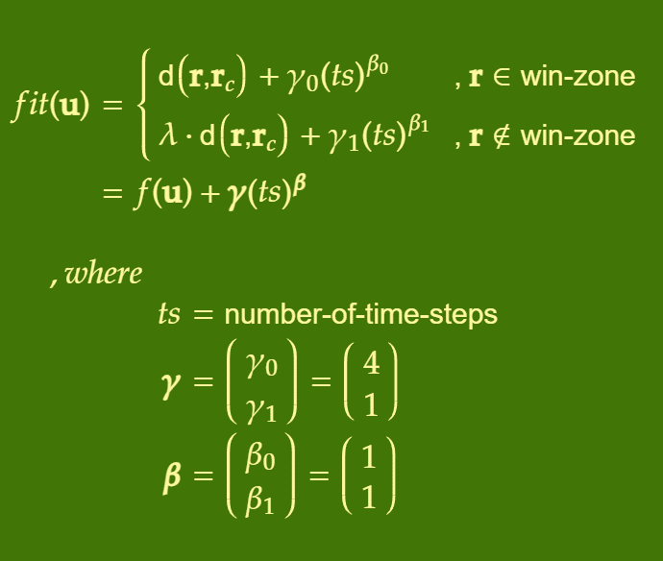
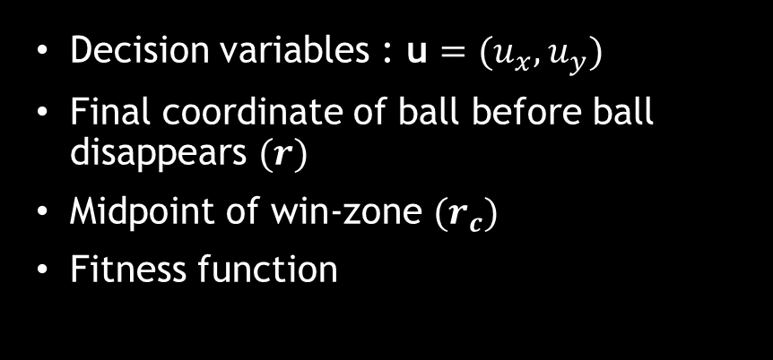
Objective Function-2
Decision variables : u $=(u_{x},u_{y})$
Final coordinate of ball before ball disappears $(r)$
Midpoint of win-zone $(r_{c})$
Fitness function

Slide 8
First Approach
Brute force shallow search

Slide 9


Brute Force Shallow Search
Assumptions
Range of $u_{x}=[0,5]$
Range of $u_{y}=[−5,5]$
Step-Size = 0.01
Requirement
u is a solution if and only if $f(\text{u})$ is atmost 57 as per the given boundaries.

Slide 10
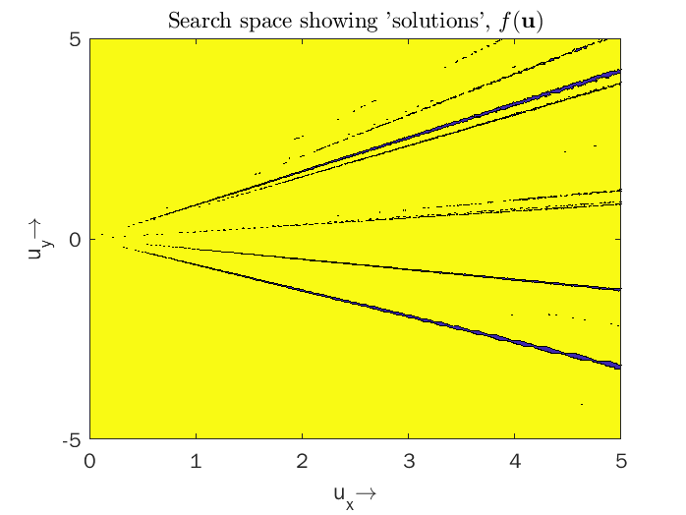

Search space showing ‘solutions’, $f\left(\text{u}\right)≤57$

Slide 11
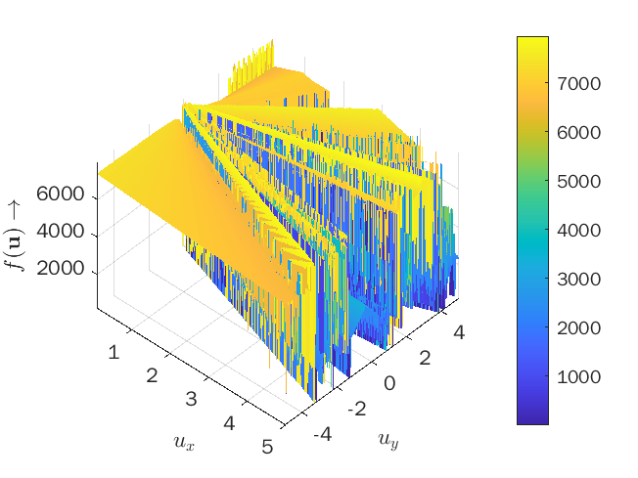
Nature of Objective Function (3D)

Slide 12
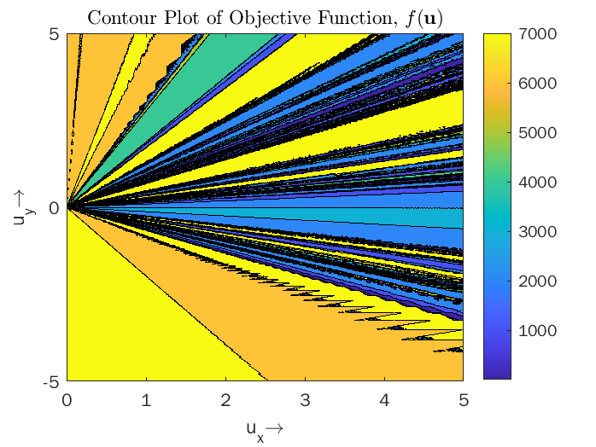
Nature of Objective Function (2D Contour Plot)

Slide 13
Comparison of Algorithms
With Objective Function - 1

Slide 14
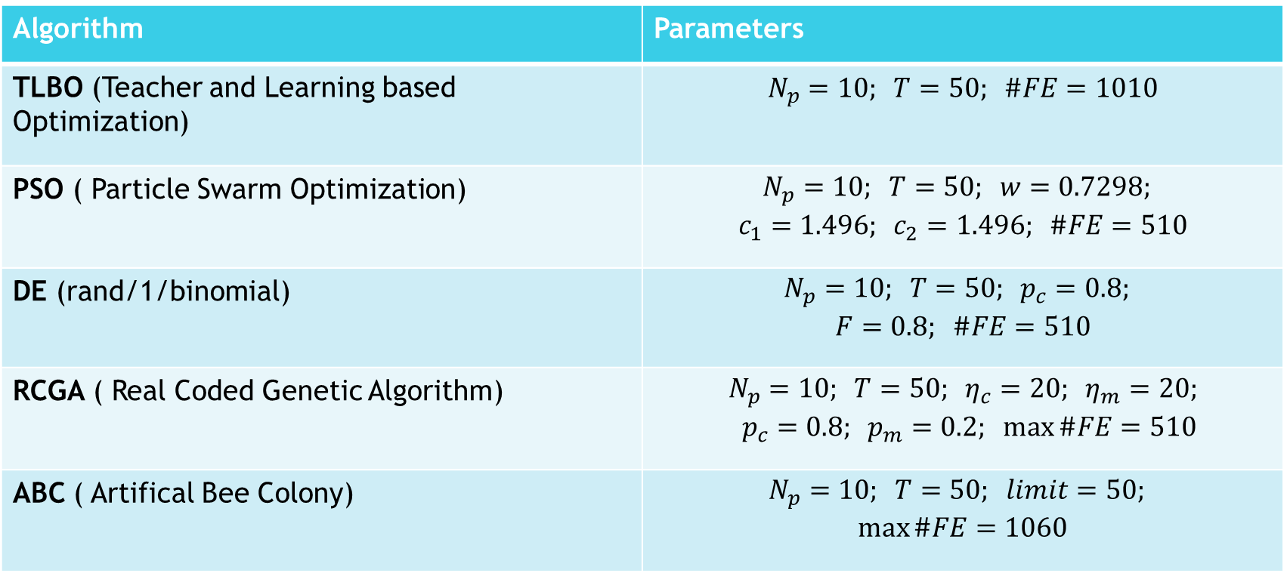
Used Metaheuristic Techniques
Algorithm | Parameters
TLBO (Teacher and Learning based Optimization) | $$N_{p}=10; T=50; \#FE=1010$$
PSO ( Particle Swarm Optimization) | $$\begin{aligned}\begin{aligned}N_{p}=10; T=50; w=0.7298; \\ c_{1}=1.496; c_{2}=1.496; \#\#\#\#FE=510\end{aligned}\end{aligned}$$
DE (rand/1/binomial) | $$\begin{aligned}N_{p}=10; T=50; p_{c}=0.8; \\ F=0.8; \#FE=510\end{aligned}$$
RCGA ( Real Coded Genetic Algorithm) | $$\begin{aligned}N_{p}=10; T=50; η_{c}=20; η_{m}=20; \\ p_{c}=0.8; p_{m}=0.2; \max{\#FE}=510\end{aligned}$$
ABC ( Artifical Bee Colony) | $$\begin{aligned}N_{p}=10; T=50; limit=50; \\ \max{\#FE}=1060\end{aligned}$$

Slide 15
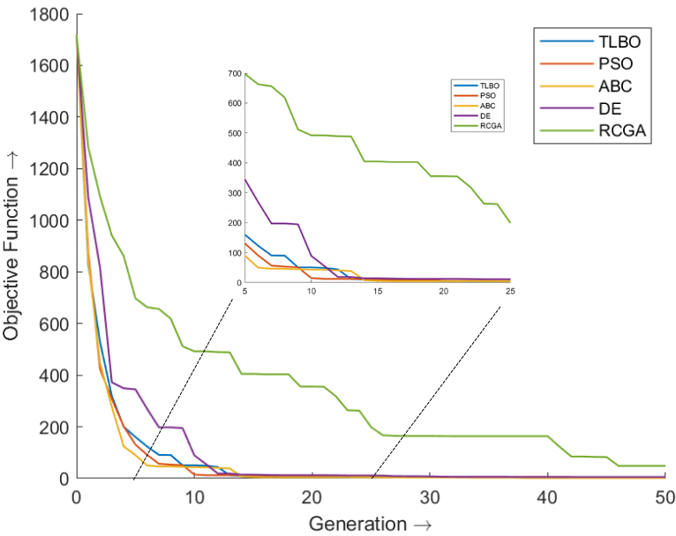
Mean of best objective function across 20 runs

Slide 16
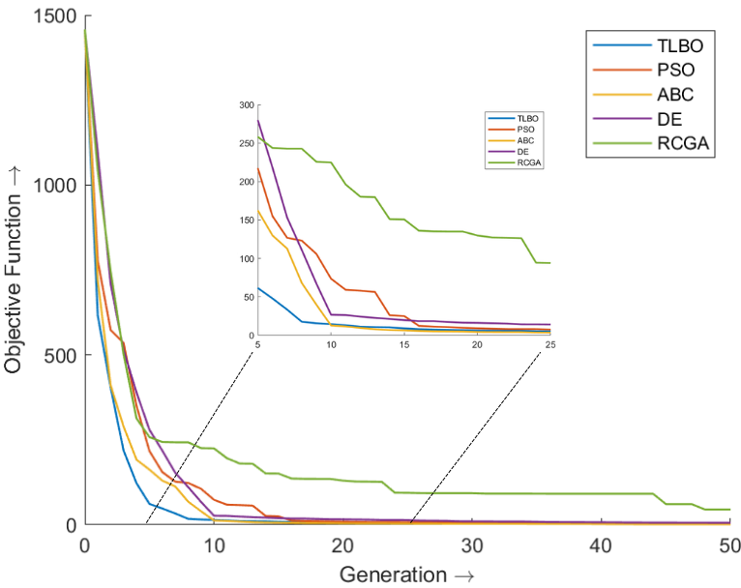
Mean of best objective function across 50 runs

Slide 17
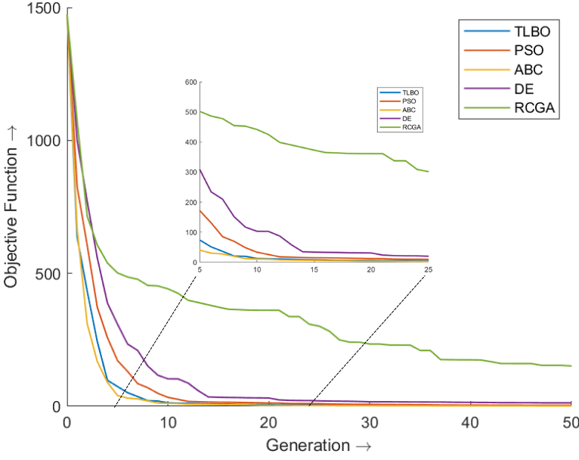
Mean of best objective function across 100 runs

Slide 18
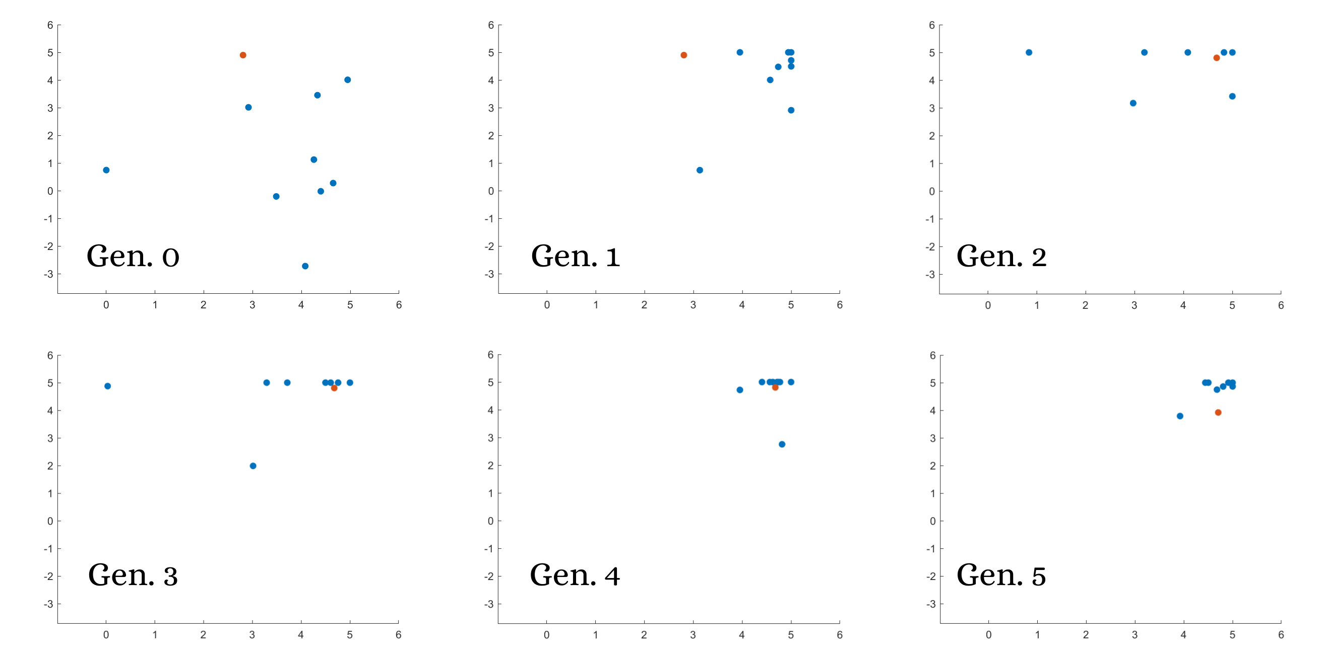
Summary
Mean behavior of RCGA (for chosen parameters) gave the worst result.
TLBO, PSO and ABC perform the best.
Considering #FE, the “best” algorithm for this problem would be PSO.

Slide 19
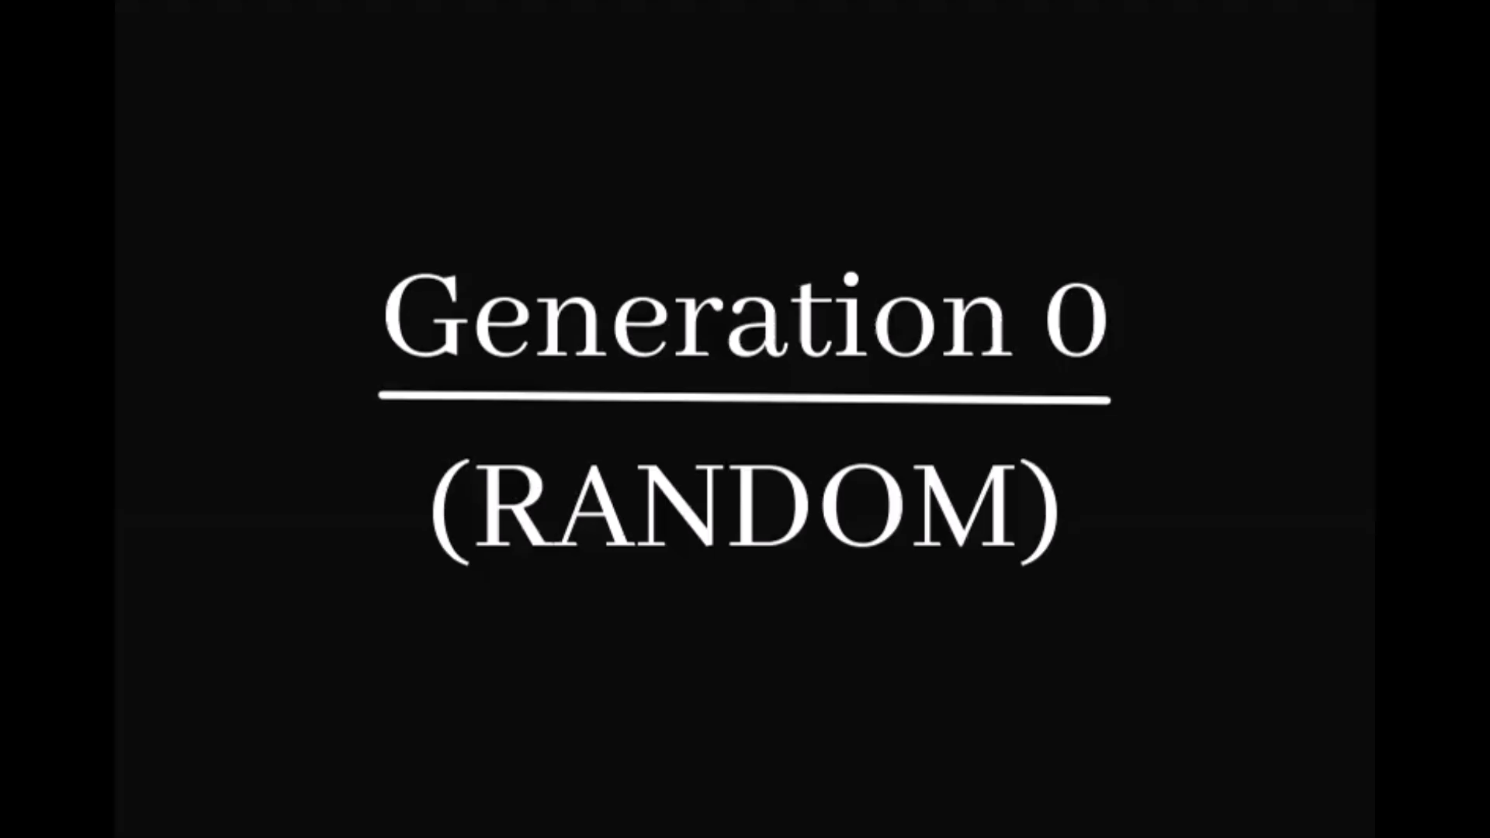
Actual Evolution of Simulation (animated)

Slide 20
Comparison of Algorithms
With Objective Function - 2

Slide 21
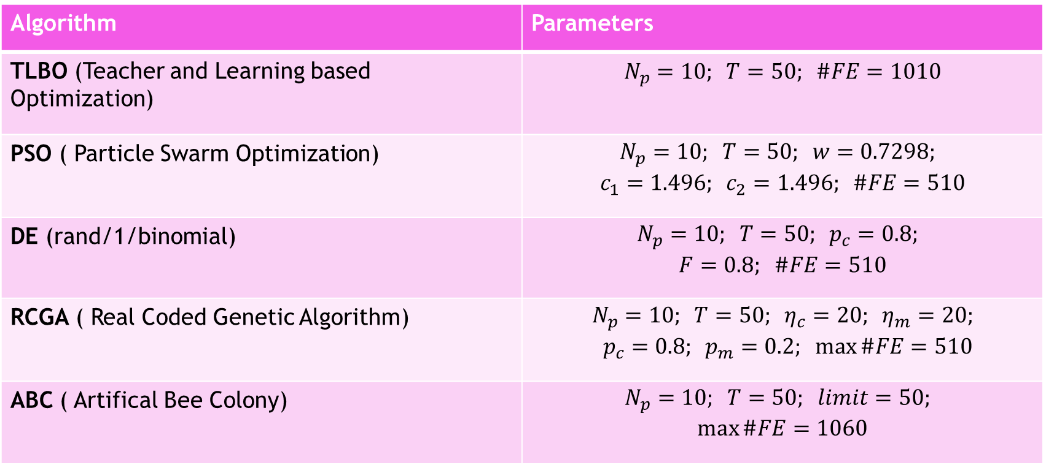
Used Metaheuristic Techniques
Algorithm | Parameters
TLBO (Teacher and Learning based Optimization) | $$N_{p}=10; T=50; \#FE=1010$$
PSO ( Particle Swarm Optimization) | $$\begin{aligned}\begin{aligned}N_{p}=10; T=50; w=0.7298; \\ c_{1}=1.496; c_{2}=1.496; \#\#\#\#FE=510\end{aligned}\end{aligned}$$
DE (rand/1/binomial) | $$\begin{aligned}N_{p}=10; T=50; p_{c}=0.8; \\ F=0.8; \#FE=510\end{aligned}$$
RCGA ( Real Coded Genetic Algorithm) | $$\begin{aligned}N_{p}=10; T=50; η_{c}=20; η_{m}=20; \\ p_{c}=0.8; p_{m}=0.2; \max{\#FE}=510\end{aligned}$$
ABC ( Artifical Bee Colony) | $$\begin{aligned}N_{p}=10; T=50; limit=50; \\ \max{\#FE}=1060\end{aligned}$$

Slide 22
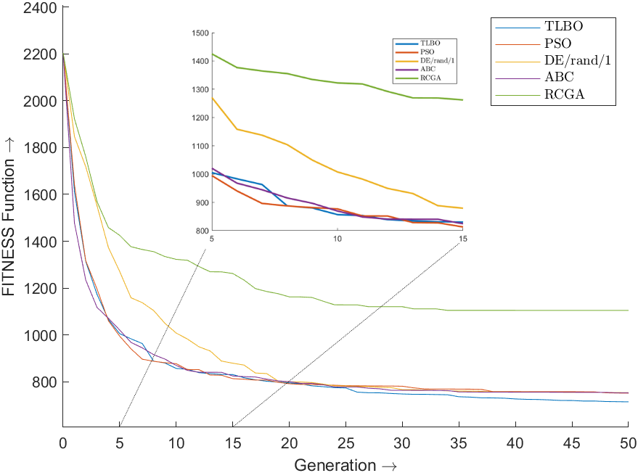

Mean of Best Fitness Function Values, $fit(\text{u})$ across 50 runs

Slide 23
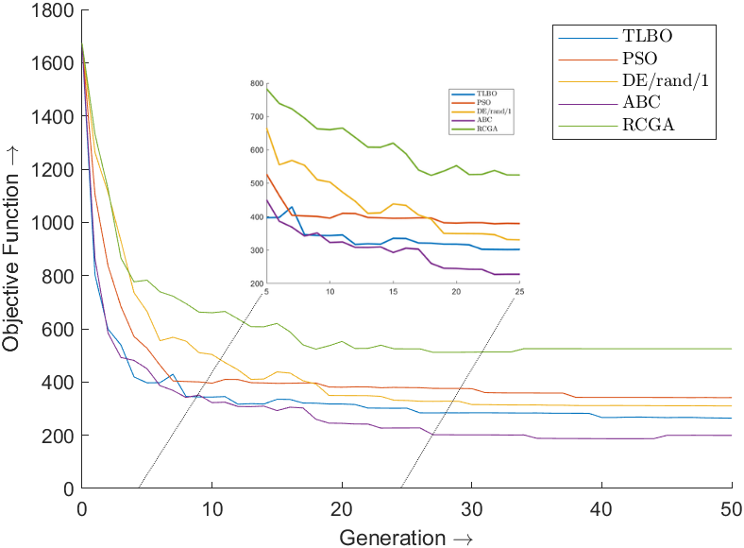

Mean of Corresponding Objective Function Values, $f(\text{u})$ across 50 runs

Slide 24
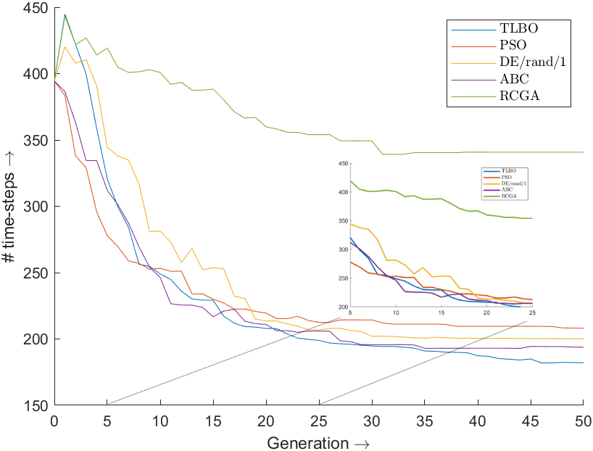

Mean of Corresponding “time-step” Values, $ts(\text{u})$ across 50 runs

Slide 25
Project Summary

Slide 26
Conclusion
Assigned an objective function to an abstract and complicated physics-based zero-player game.
Applied and Compared existing metaheuristic techniques to this objective function.
The algorithms performed well, and the solution was reached within a few generations.
Added an additional objective of minimization of the time taken for the ball to end up in the end-zone.
Used weighted-sum method (albeit in a piece-wise sense) for this “multi-objective” optimization, choosing the weights (representing the relative importance of objectives).
Possible future endeavour – try to add complex problems (inelastic walls, massy finite-sized ”planets” with gravitational fields, massless finite-size ”charges” with electrostatic field and viscous mediums) and deploy a GUI on the web to add to existing rich text of “applicability of metaheuristic techniques” another beautiful (and definitely esoteric!) example.

Slide 27
References
L. Zadeh, ”Optimality and non-scalar-valued performance criteria,” in IEEE Transactions on Automatic Control, vol. 8, no. 1, pp. 59-60, January 1963, doi: 10.1109/TAC.1963.1105511.
Martin Gardner (October 1970), ”Mathematical games: The fantastic combinations of John Conway’s new solitaire game ’Life’”, Scientific American
Reas, C. and Fry, B. Processing: programming for the media arts (2006). Journal AI Society, volume 20(4), pages 526-538, Springer

Slide 28
Code

